Slide 1
CURRENCY CONVERTER
Real-time currency exchange
Guided by-Prof. Mansi Shah

Slide 2
TABLE OF CONTENTS
01
Introduction
05
Flowchart
02
06
Abstract of Project
03
Problem statement
Our Team
04
Gannt chart
ONLINE CURRENCY CONVERTER SCREEN
07
06
Resources

Slide 3
CURRENCY CONVERTER
The program should have a range of currency types for it to work properly and calculate the exchanged amount between all of the currencies – this will involve setting the decimal data type properly. It has to be user-friendly and aesthetically pleasing – it has to look good, presentable and be easy to use.

Slide 4
INTRODUCTION
An website is to be developed to represent dynamic functionalities like online currency converter. The application can simultaneously convert to currency using an online information source. Different countries use different currencies and these currencies change daily compared to each other. Those who have transferred money (one currency to another) from one country to another must be updated with the latest currency exchange rates in the market. With this in mind, the Currency Converter project has been created. there are regular updates about each country's currency by which it reflects the current currency market value and conversion rate. Such an website can be used by any user, but it is mainly useful for business, shares and finance related areas where money transfer and currency exchange takes place daily. In this currency converter app, users are given the option to choose the type of conversion, i.e. "this" currency to "to" currency. This simple feature allows users to enter the amount to convert (say currency in dollars) and display the converted amount (say currency in euros). Real Time Currency Converter converts user-assigned currency into just one currency.

Slide 5
ABSTRACT OF PROJECT
Different countries use different currencies and these currencies change daily compared to each other. Those who have transferred money (one currency to another) from one country to another must be updated with the latest currency exchange rates in the market. With this in mind, the Currency Converter project has been created. In this website, there are regular updates about each country's currency by which it reflects the current currency market value and conversion rate. Such an website can be used by any user, but it is mainly useful for business, shares and finance related areas where money transfer and currency exchange takes place daily. In this currency converter app, users are given the option to choose the type of conversion, i.e. "this" currency to "to" currency. This simple feature allows users to enter the amount to convert (say currency in dollars) and display the converted amount (say currency in euros).

Slide 6
PROBLEM STATEMENT
Creating a real-time currency converter that will take data from authenticated sources that are looking to invest abroad or perhaps going on holiday will reduce the time it takes to serve customers and they need local currency to buy goods. it is mainly useful for business, shares and finance related areas where money transfer and currency exchange takes place daily.

Slide 7
—Robert Harris
“The true currency of life is time, not money, and we've all got a limited stock of that.”

Slide 8
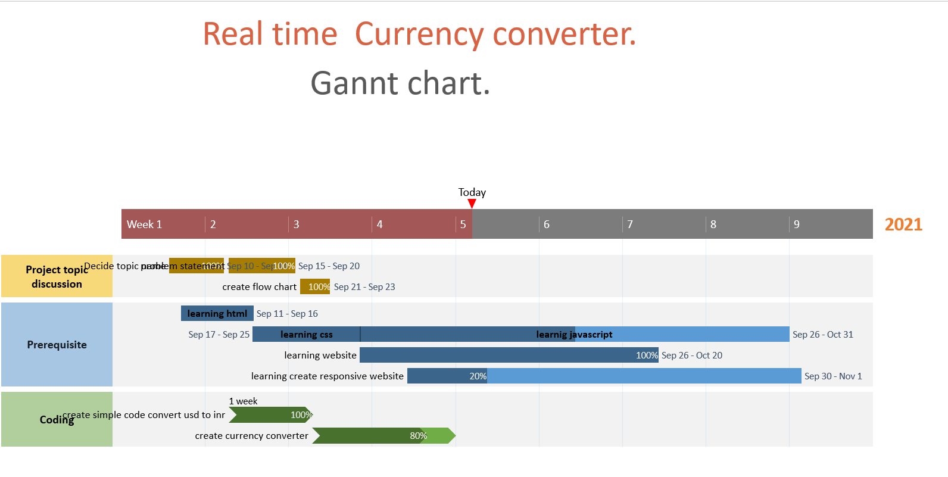
GANNT CHART

Slide 9
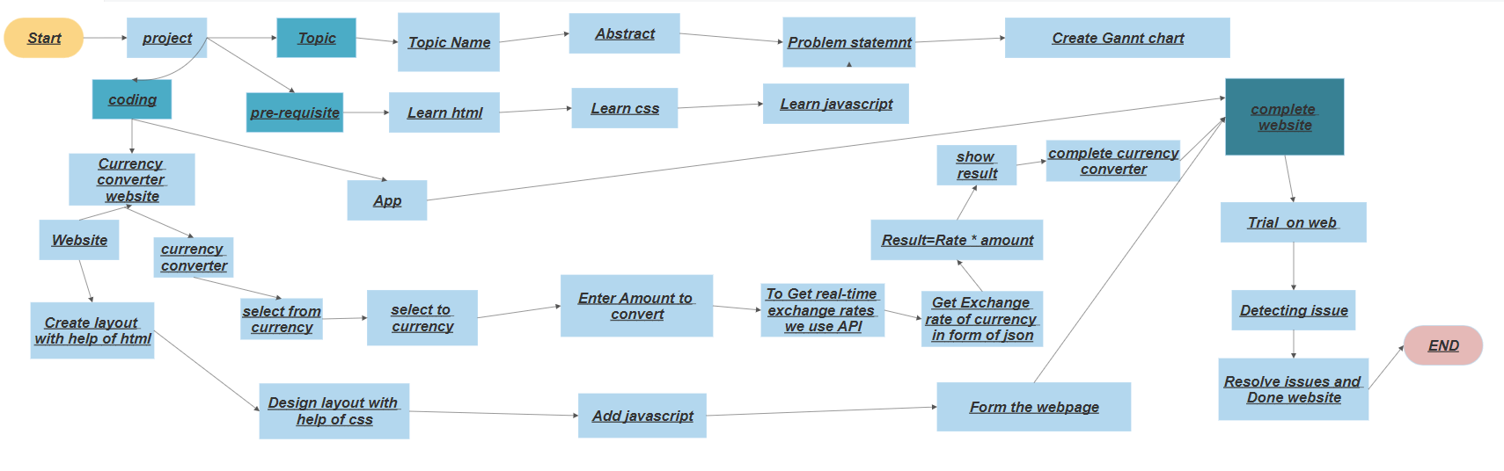
FLOWCHART

Slide 10
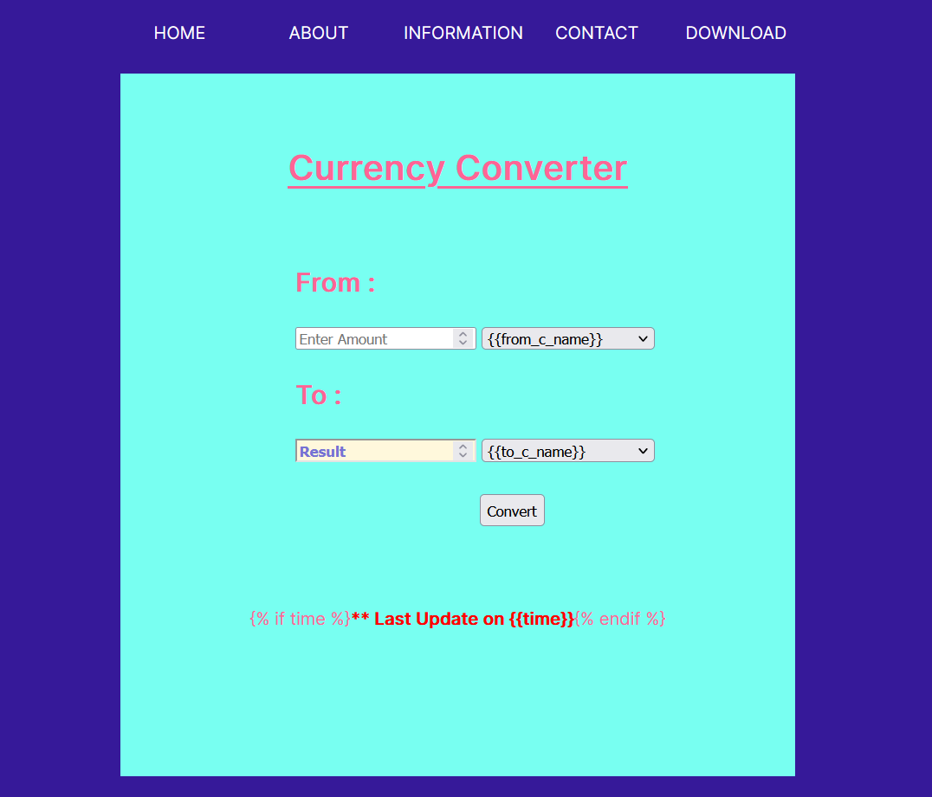
ONLINE CURRENCY CONVERTER SCREEN

Slide 11
THE TEAM
Shaikh affan sajid
9967863217
affu01@eng.rizvi.edu.in
Soham shrikant manjrekar
7045208474
sohammanjrekar@eng.edu.rizvi.in
Mohammed baquir sayed
88507737784
baquirsayed@eng.rizvi.edu.in
Suchit Sawant
7700990265
suchitsawant@eng.rizvi.edu.in

Slide 12
RESOURCES
Did you like the resources on this template? Get them for free at our other websites.
PHOTOS
Young businessman with hands in his pocket talking on mobile phone
Smiling ethnic woman with gray laptop
Smiling young man busy in texting message to someone
VECTORS
Flat computer engineering concept
Circuit of user experience
Timeline infographic
Logotype collection
Flat social media multimedia player templa
Gradient technology logo template collection
Digital marketing landing page template
Colorful responsive landing page
Modern web design concept with hand drawn style
App development concept with flat design

Slide 13
THANKS!
Does anyone have any question?
+91 7045208474 /9967863217
sohammanjrekar@eng.rizvi.edu.in
affu01@eng.rizvi.edu.in
baquirsayed@eng.rizvi.edu.in
suchitsawant@eng.rizvi.edu.in

Slide 14
PROJECT STAGES
STEP 2
STEP 1
STEP 3
Venus has a beautiful name and is the second planet from the Sun
Despite being red, Mars is a cold place, not hot. It’s full of iron oxide dust
Saturn is a gas giant, composed mostly of hydrogen and helium

Slide 15

Steps to Build the Currency Converter project

Slide 16
IMPORT THE LIBRARIES
from flask import Flask,render_template,request
import requests
import os

Slide 17
CREATING A FLASK APP AND NAME IT 'APP’
app = Flask(__name__)

Slide 18
API KEY TAKEN FROM 'WWW.ALPHAVANTAGE.CO’
if 'API_KEY' in os.environ:
API_KEY = os.environ['API_KEY']
else:
API_KEY = 'RQM7GIDWT0ZU2WLU'

Slide 19
DEFAULT ('/') ROUTE OF THE APPLICATION
@app.route('/',methods=['GET','POST’])
def home():

Slide 20
EXECUTES WHEN USERS MAKE A POST REQUEST TO THE SERVER
if request.method == 'POST':
try:

Slide 21
EXTRACTING DATA (INCLUDE --> AMOUNT:GIVEN AMOUNT,FROM_C:CONVERT FROM WHICH CURRENCY,TO_C:CONVERT TO WHICH CURRENCY) GIVEN BY USER TO THE SERVER
amount = request.form['amount']
amount = float(amount)
from_c = request.form['from_c']
to_c = request.form['to_c']

Slide 22
MAKING OF THE PROPER URL BEFORE CREATE A GET REQUEST TO 'WWW.ALPHAVANTAGE.CO' API SERVICE
url = 'https://www.alphavantage.co/query?function=CURRENCY_EXCHANGE_RATE&from_currency={}&to_currency={}&apikey={}'.format(from_c,to_c,API_KEY)

Slide 23
CALCULATING THE AMOUNT ACCORDING TO THE CURRENCY EXCHANGE RATE AND STORE THE VALUE TO 'RESULT' VARIABLE
rate = response['Realtime Currency Exchange Rate']['5. Exchange Rate']
rate = float(rate)
result = rate * amount

Slide 24
MAKE THE GET REQUEST TO 'WWW.ALPHAVANTAGE.CO' API SERVICE AND THEN STORE THE RESPONSE TO 'RESPONSE' VARIABLE
response = requests.get(url=url).json()
To get real-time exchange rates, we will use: www.alphavantage.co Here, we can see the data in JSON format, with the following details:
Base – USD: It means we have our base currency USD. which means to convert any currency we have to first convert it to USD then from USD, we will convert it in whichever currency we want.
Date and time: It shows the last updated date and time.
Rates: It is the exchange rate of currencies with base currency USD.

Slide 25
EXTRACTING ALL OTHER NECESSARY INFORMATION FROM 'RESPONSE' TO DISPLAY IN WEB-PAGE
from_c_code = response['Realtime Currency Exchange Rate']['1. From_Currency Code']
from_c_name = response['Realtime Currency Exchange Rate']['2. From_Currency Name']
to_c_code = response['Realtime Currency Exchange Rate']['3. To_Currency Code']
to_c_name = response['Realtime Currency Exchange Rate']['4. To_Currency Name']
time = response['Realtime Currency Exchange Rate']['6. Last Refreshed']

Slide 26
IT RETURNS TO HOME PAGE OF APPLICATION WITH ESSENTIAL INFORMATION FOR DISPLAYING TO USER
return render_template('home.html', result=round(result,2), amount=amount, from_c_code=from_c_code, from_c_name=from_c_name, to_c_code=to_c_code, to_c_name=to_c_name, time=time)

Slide 27
IF SERVER FAILS TO RESPONSE THEN DISPLAY AN ERROR MESSAGE
except Exception as e:
return'<h1>BadRequest:{}</h1>'.format(e)

Slide 28
RUNNING THE SERVER/APP, WHEN THIS FILE WILL BE EXECUTED/RUN
if __name__ == "__main__": app.run(debug= True)

Slide 29
IF USER MAKE A SIMPLE GET REQUEST TO THIS SERVER IT RETURNS 'HOME.HTML' PAGE
else:
return render_template('home.html')

Slide 30
RUNNING THE SERVER/APP, WHEN THIS FILE WILL BE EXECUTED/RUN
if __name__ == "__main__": app.run(debug= True)

Slide 31
SUMMARY

